Slide 1
Ship control and classification
Professor Erik Røsæg
Nordisk institutt for sjørett
erik.rosag@jus.uio.no
folk.uio.no/erikro

Slide 2
Some basic instruments
SOLAS
Torremolinos Convention
Marpol
Load Lines
STCW
ISPS
Paris Memorandum
ISM Code

Slide 3
Some general remarks on conventions
Tacit amendment
Grandfather clauses

Slide 4
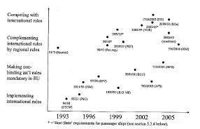
EU and EMSA
Erika packages
EU initiatives

Slide 5
Classification
Classification societies
Relationship to public authorities
Liability

Slide 6
Flags of Convenience
The issue
Safety culture?

Slide 7
Safety as a contractual term
Shipbuiding
Charterparties
Etc
Amended rules

Slide 8
Ship Safety Act
NMD
Responsible party
Investigation Board
Police

Slide 9
Sanctions
Administrative sanctions
Penal sanctions
Personal
Company
Forfeiure

Slide 10
Dangerous cargoes
The problem
Safety rules
Reporting

Slide 11
Port State Control
The basic principle
Host state control
Port of emergency
Ports of refuge
Creeping jurisdiction
GHG

Slide 12
Offshore safety
UNCLOS jurisdiction
National jurisdiction
Some observations of safety systems and cultures

